Slide 1
Laser-Based Wireless Power Transmission Receiver’s Energy Harvester: Photovoltaic Power Converter Board
Haruka Kido
University of North Dakota
EE481. Senior Design II

Slide 2
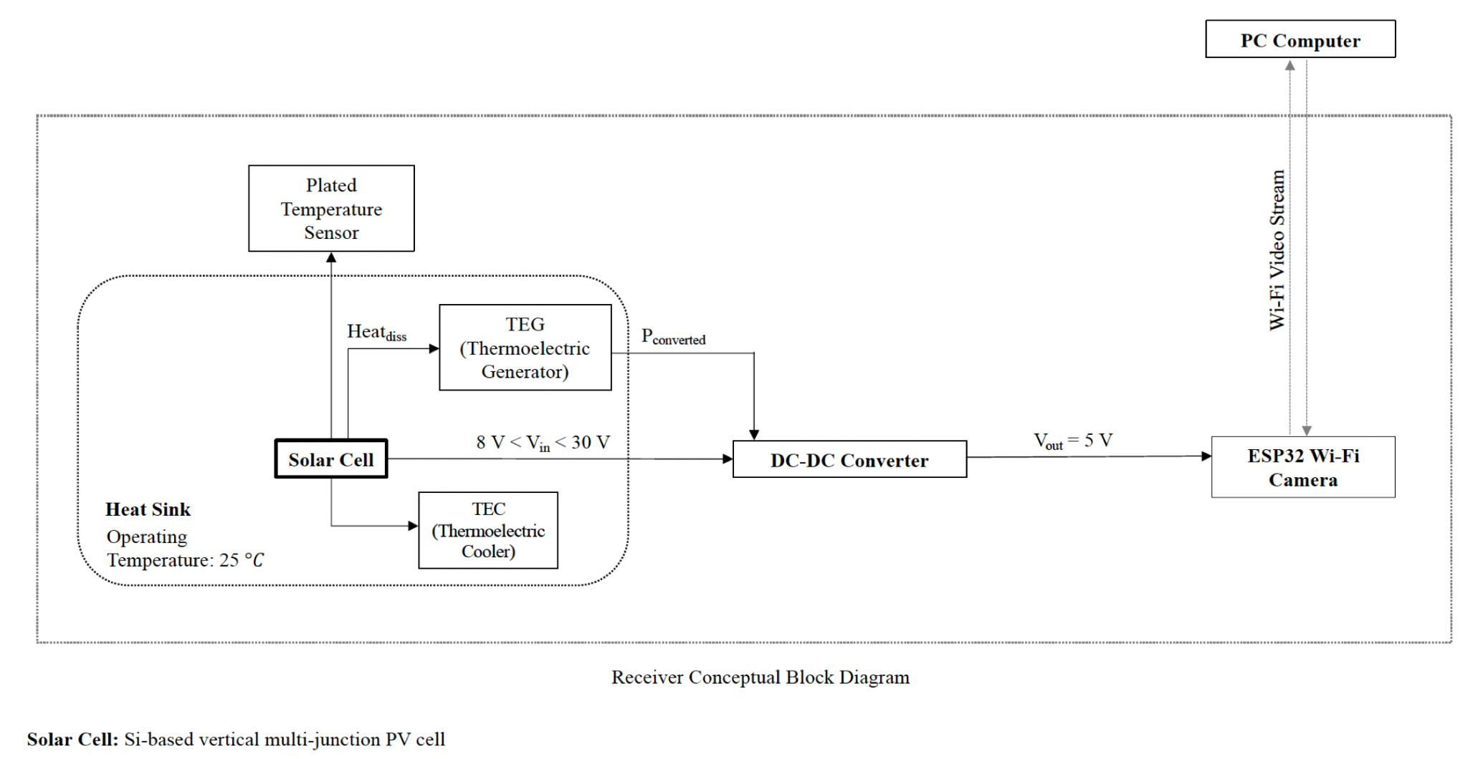
Receiver Conceptual Block Diagram

Slide 3
Design Objective: Rapid Prototyping for Testing
To replace the isolated LM2596 DC-DC Converter board with a compact Power Converter solution combined with a thermal regulation and energy harvesting system
To provide a spatial layout for the PV cells with consideration to the TEC’s placement beneath the board
To implement either the Buck “step-down” or Boost “step-up” voltage converter mechanism from the quad-PV array to the camera load (Note: The selection between Buck or Boost DC-DC Converter depends on wattage output from the 4 PV cells)
To implement a voltage-controlled power electronic system with ON-OFF switching and low-pass filter or to provide an extension board to do so
To make a top-layer backplane system so the PV cells can be easily soldered to the PCB solder pads without electrode wiring or external cabling and so the load camera can also be soldered to the load output connector
To minimize conduction losses and use power distribution techniques in a condensed form
To verify the highest efficiency power converter board as part of the testing and performance evaluation
To provide boards with test pads for fault detection during testing

Slide 4
Design Tools
TI WEBENCH Power Designer
Autodesk EAGLE
Digi-Key’s PCB Trace Width Calculator
PCB fabrication machines
Soldering equipment

Slide 5
PV Cell Form Factors
39.37008 mils = 1 mm
1 mil = 0.0254 mm (millimeter)
1 cm x 1 cm (10 mm x 10 mm) MIH® VMJ PV Cell Form Factor (Part #: 5S1010.4)
2.5 cm x 2.5 cm (25 mm x 25 mm) PV Cell Form Factor
5 cm x 5 cm (50 mm x 50 mm) PV Cell Form Factor
Total number of form factors: 3
PV Cell Electrical Arrangement Types
Isolated: Configurable Externally for Adaptive Methods
Series
Parallel
Total number of arrangements: 3
Total number of possible board prototypes: 9
Total number of design files for board prototypes: 7 (due to adjustable dimensions and tolerances from same circuitries)

Slide 6
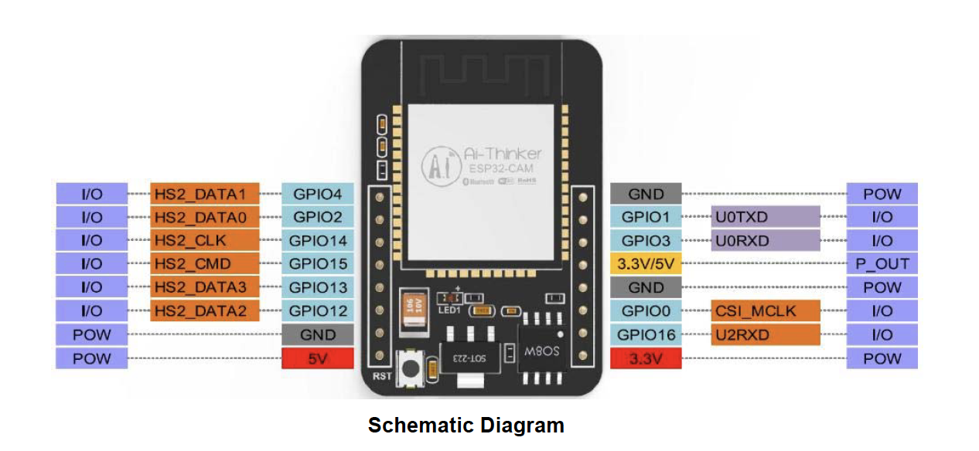
ESP-32 Wi-Fi Load Input Requirements
Power consumption is
(180 mA x 5V) = 900mW = 0.9 W
(Flash OFF)

Slide 7
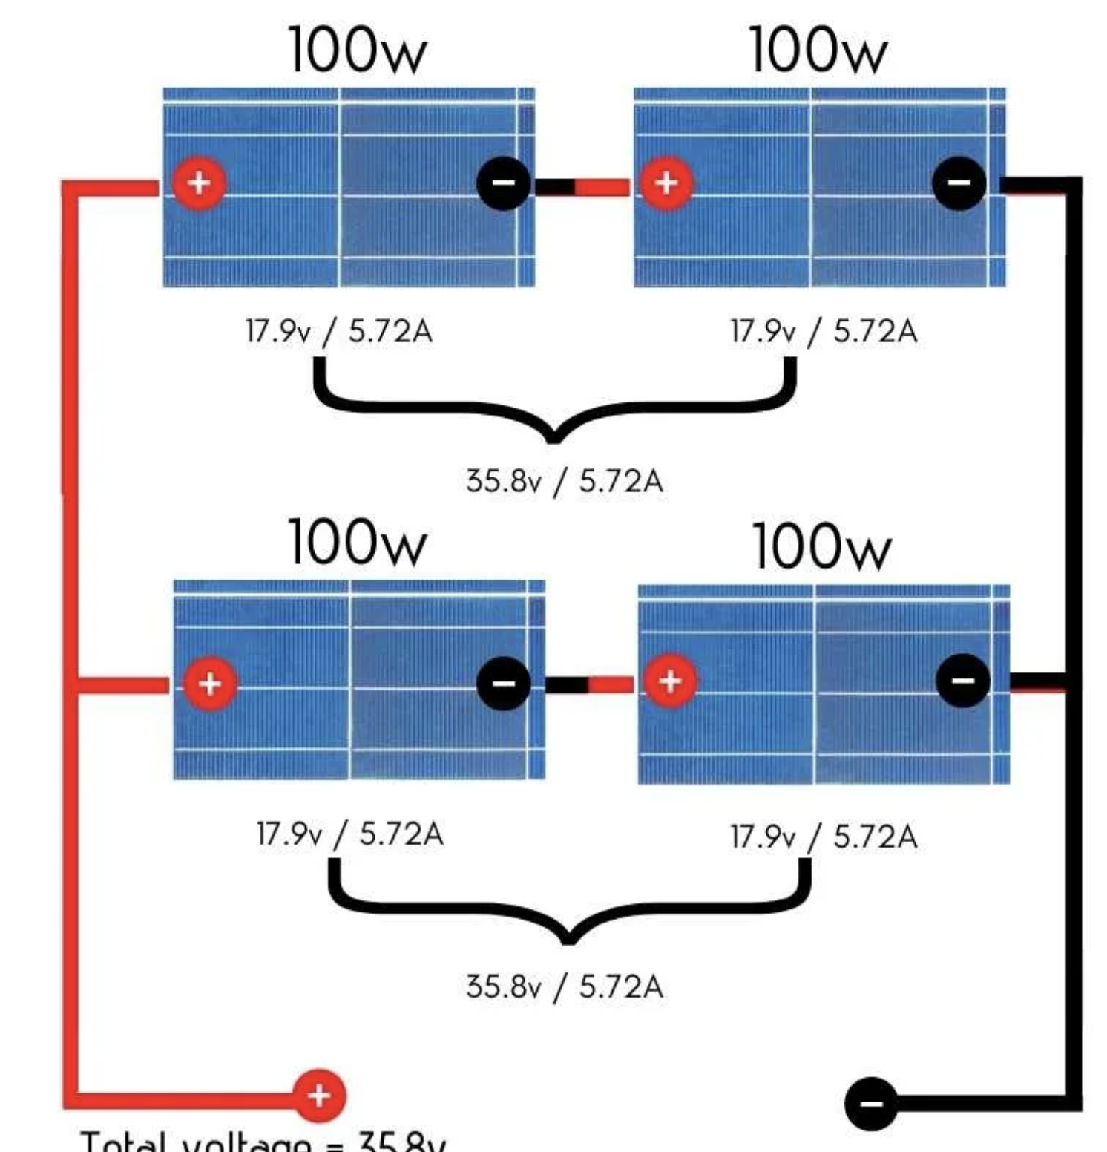
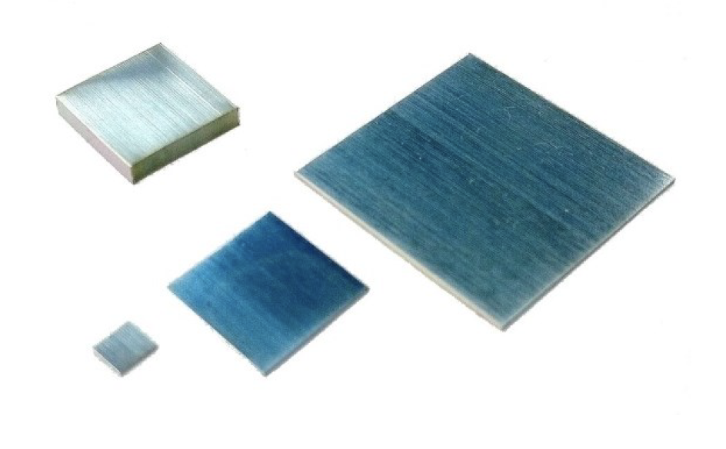
1. Design Specifications 1 cm x 1 cm MIH® VMJ PV Cell Form Factor, 4-PV, Series; Extension Board: Configurable for Externally Adaptive Load Circuitry
Peripherals:
Inputs:
PV Array: 2 leads (+ and -) x 4 PV cells = 8 leads
TEG module’s 2 leads (+ and -)
TEC module’s 2 leads (+ and -)
Outputs:
ESP-32 Wi-Fi camera
Internals:
Pads for soldered PV cells
I/O Ports as Female Connectors
Voltage Requirements:
Input:
Each PV cell has a 0.02029 A maximum current output
Each PV cell has a 29.21 V maximum voltage output
Each PV cell has a 0.59267 W maximum power output
Total max V_{out} = 29.21 V x 4 PV cells; Voltage output = 116.84 V for a series connection
Total max current = 0.02029 A for a series connection
Output: 5 V at 180 mA *or .18 A = 0.9 W
Miscellaneous:
Heat Sink
*Required Separately: Buck DC-DC Converter circuit: 116.84 V to 5 V

Slide 8
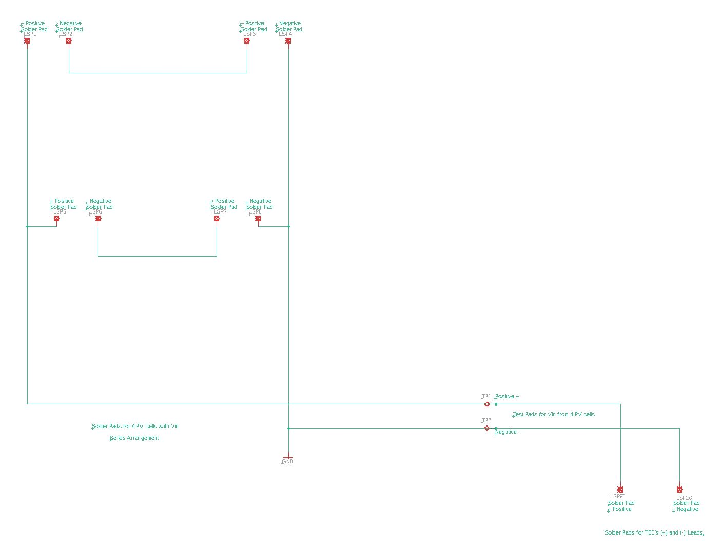
1.

Slide 9
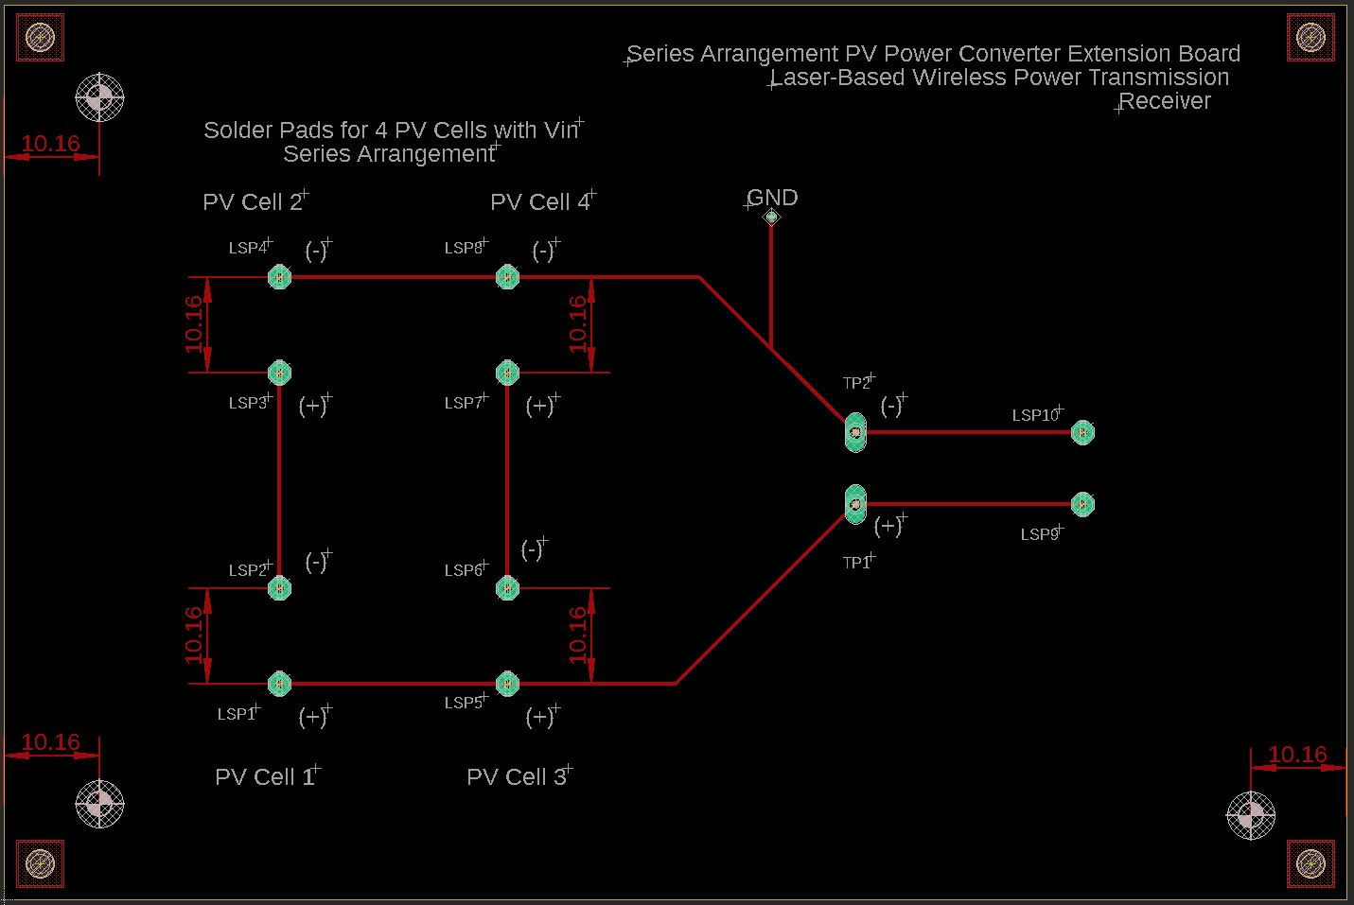
1.

Slide 10
2. Design Specifications 1 cm x 1 cm MIH® VMJ PV Cell Form Factor, 1-PV; Full Backplane Board
Peripherals:
Inputs:
PV Array: 2 leads (+ and -)
TEG module’s 2 leads (+ and -)
TEC module’s 2 leads (+ and -)
Outputs:
ESP-32 Wi-Fi camera
Internals:
Pads for soldered PV cells
PWM Control DSP, MCU, or FPGA for Switch Control
Buck DC-DC Converter circuit with Low-Pass Filter: 29.21 V to 5 V
- R, L, C, MOSFET Switch (Voltage-Controlled)
I/O Ports as Female Connectors
Voltage Requirements:
Input: 8 - 30 V:
Each PV cell has a 0.59267 W maximum power output
Each PV cell has a 29.21 V maximum voltage output
Total max V_{out} = 29.21 V x 1 PV cell; Voltage output = 29.21 V for a single PV solution
Total max current = 0.02029 A for a single PV solution
Output: 5 V at 180 mA *or .18 A = 0.9 W
Miscellaneous:
Heat Sink

Slide 11
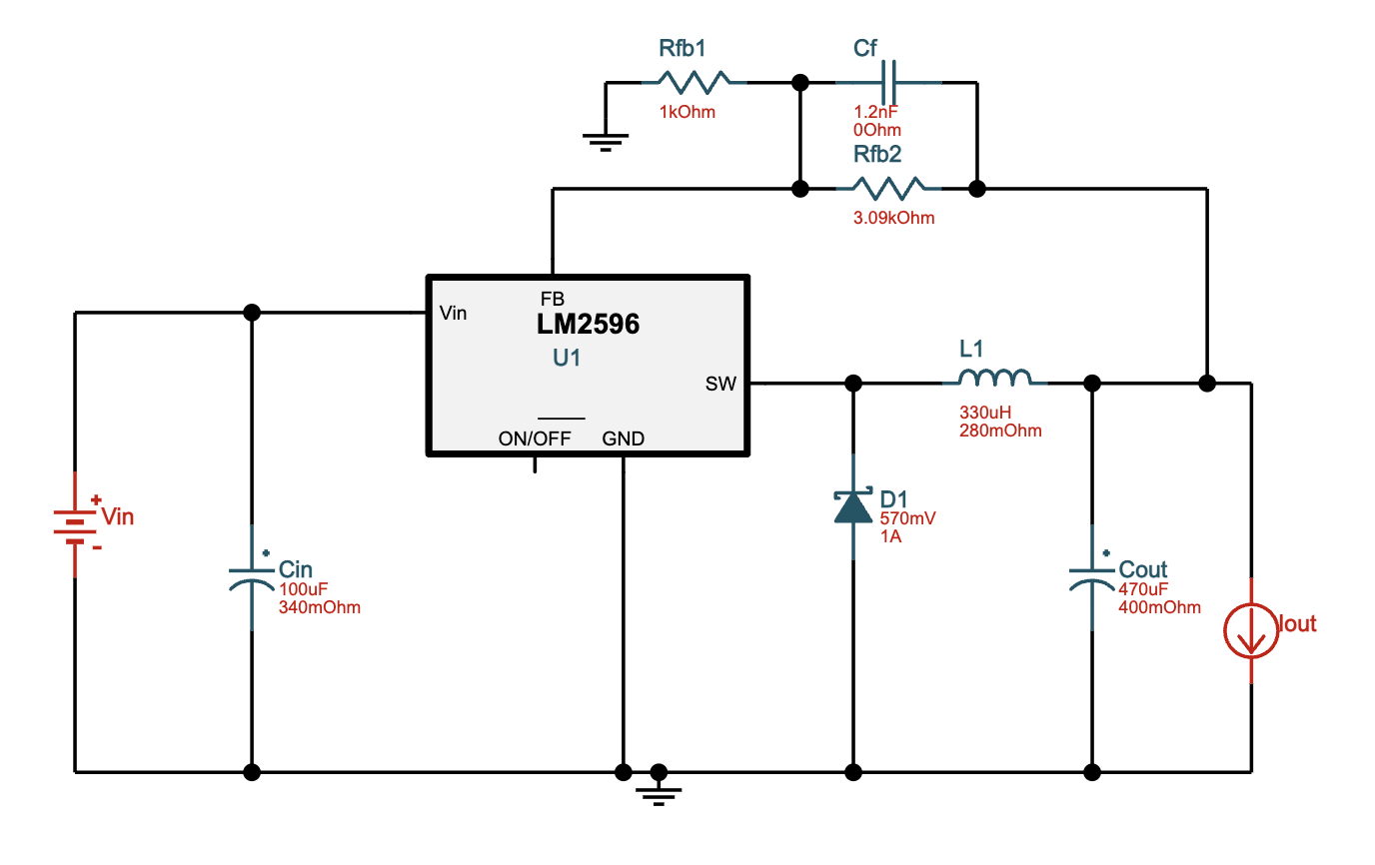
2. Buck DC-DC Converter
LM2596T-ADJ/NOPB ‑ 25V-30V to 5.00V @ 0.18A. 69.4% Efficiency

Slide 12
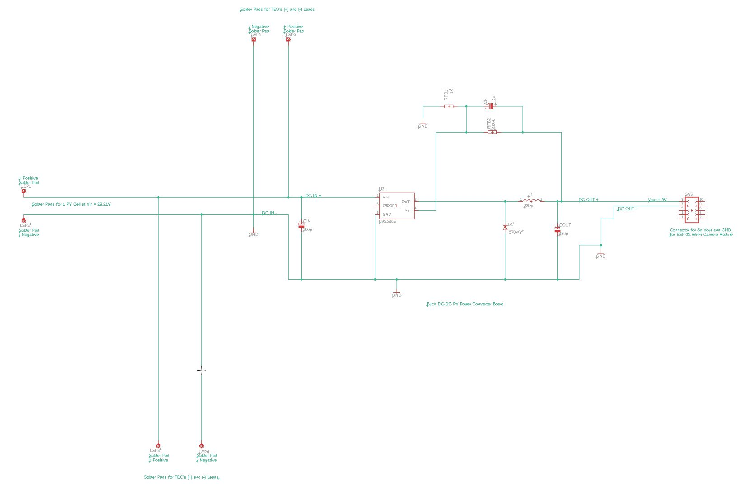
2.

Slide 13
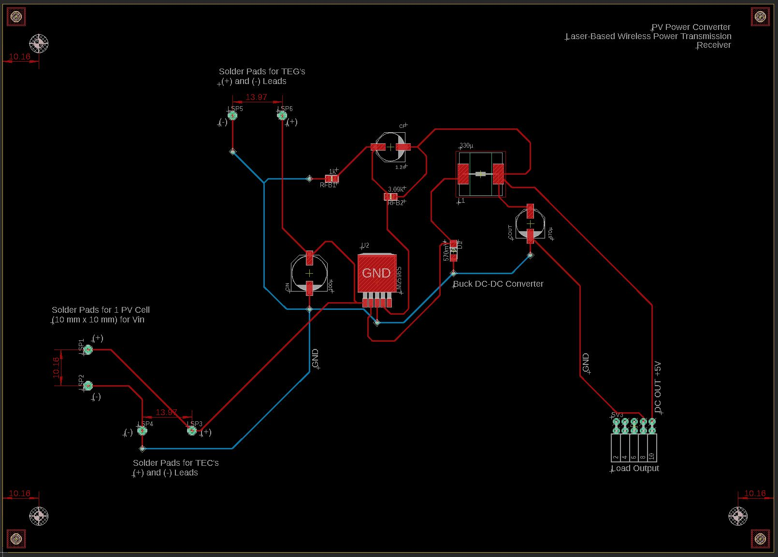
2.

Slide 14
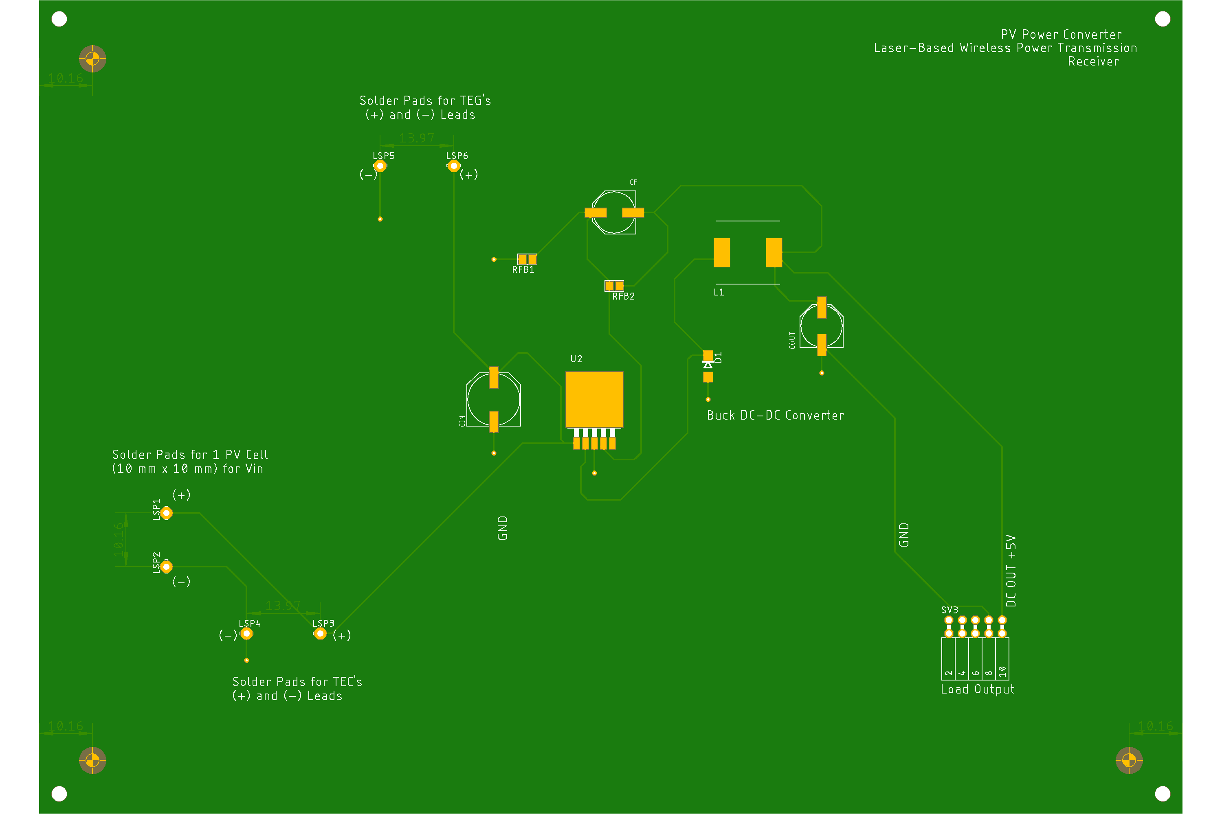
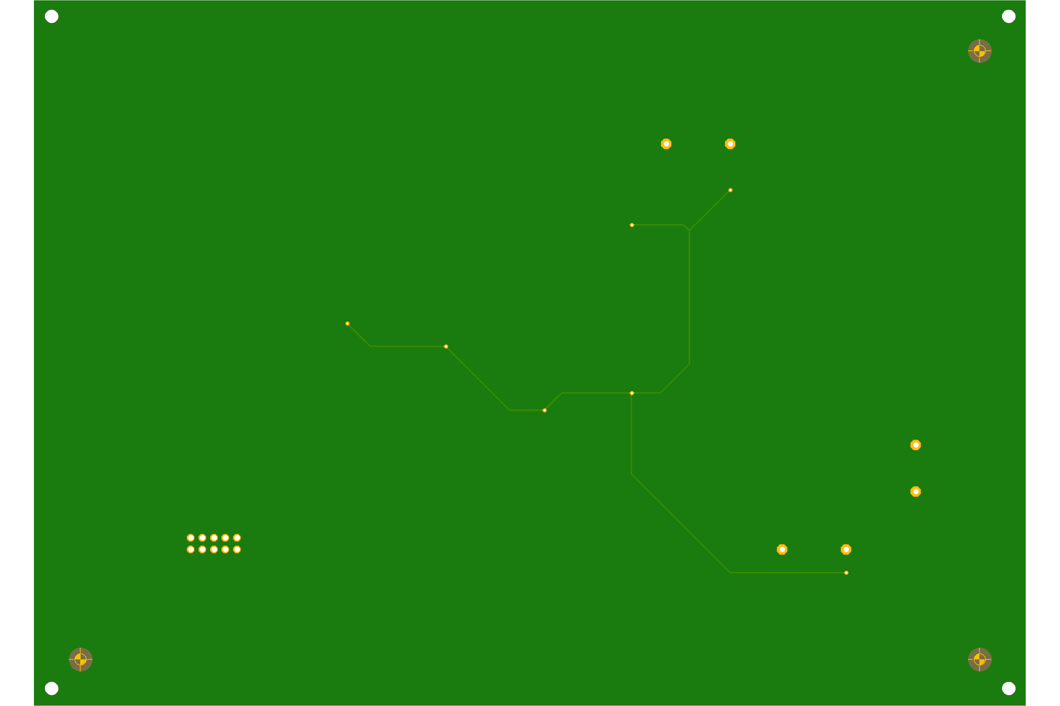
2.
Top
Bottom

Slide 15
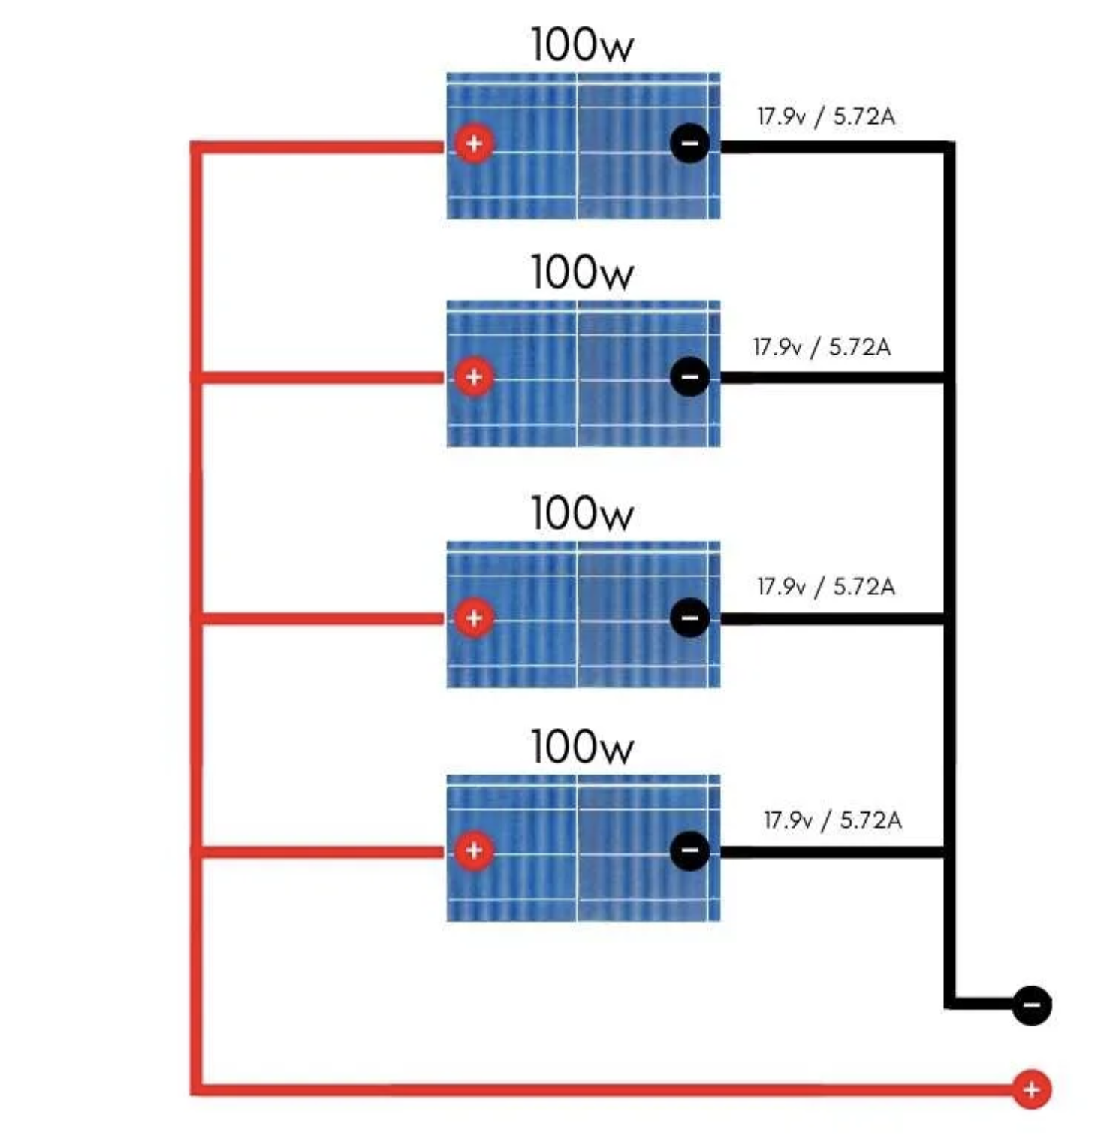
3. Design Specifications 1 cm x 1 cm MIH® VMJ PV Cell Form Factor, 4-PV, Parallel; Full Backplane Board
Peripherals:
Inputs:
PV Array: 2 leads (+ and -)
TEG module’s 2 leads (+ and -)
TEC module’s 2 leads (+ and -)
Outputs:
ESP-32 Wi-Fi camera
Internals:
Pads for soldered PV cells
PWM Control DSP, MCU, or FPGA for Switch Control
Buck DC-DC Converter circuit with Low-Pass Filter: 29.21 V to 5 V
- R, L, C, MOSFET Switch (Voltage-Controlled)
I/O Ports as Female Connectors
Voltage Requirements:
Input: 8 - 30 V:
Each PV cell has a 0.59267 W maximum power output
Each PV cell has a 29.21 V maximum voltage output
Total V_{out} = 29.21 V for a parallel connection
Total current = 0.02029 A x 4 PV cells = 0.08116 A for a parallel connection
Total power = 29.21 V x 0.08116 A = 2.3706836 W
Output: 5 V at 180 mA *or .18 A = 0.9 W
Miscellaneous:
Heat Sink

Slide 16
3. Buck DC-DC Converter
LM2596T-ADJ/NOPB ‑ 25V-30V to 5.00V @ 0.18A. 69.4% Efficiency

Slide 17
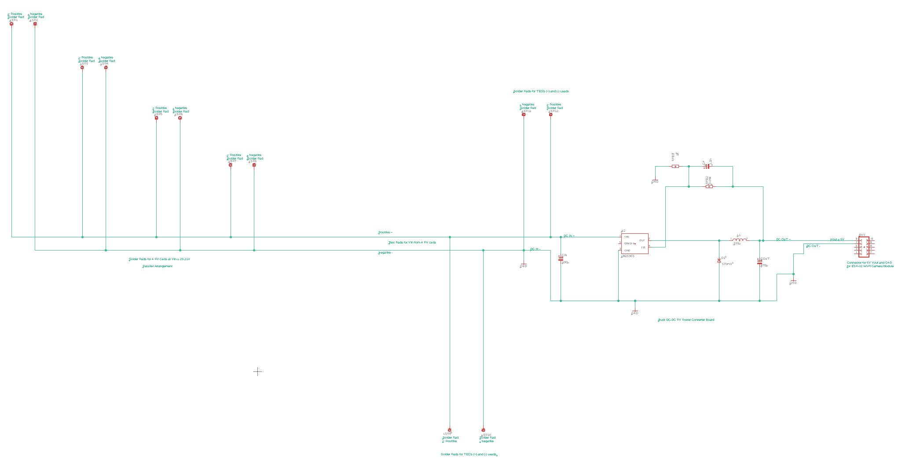
3.

Slide 18
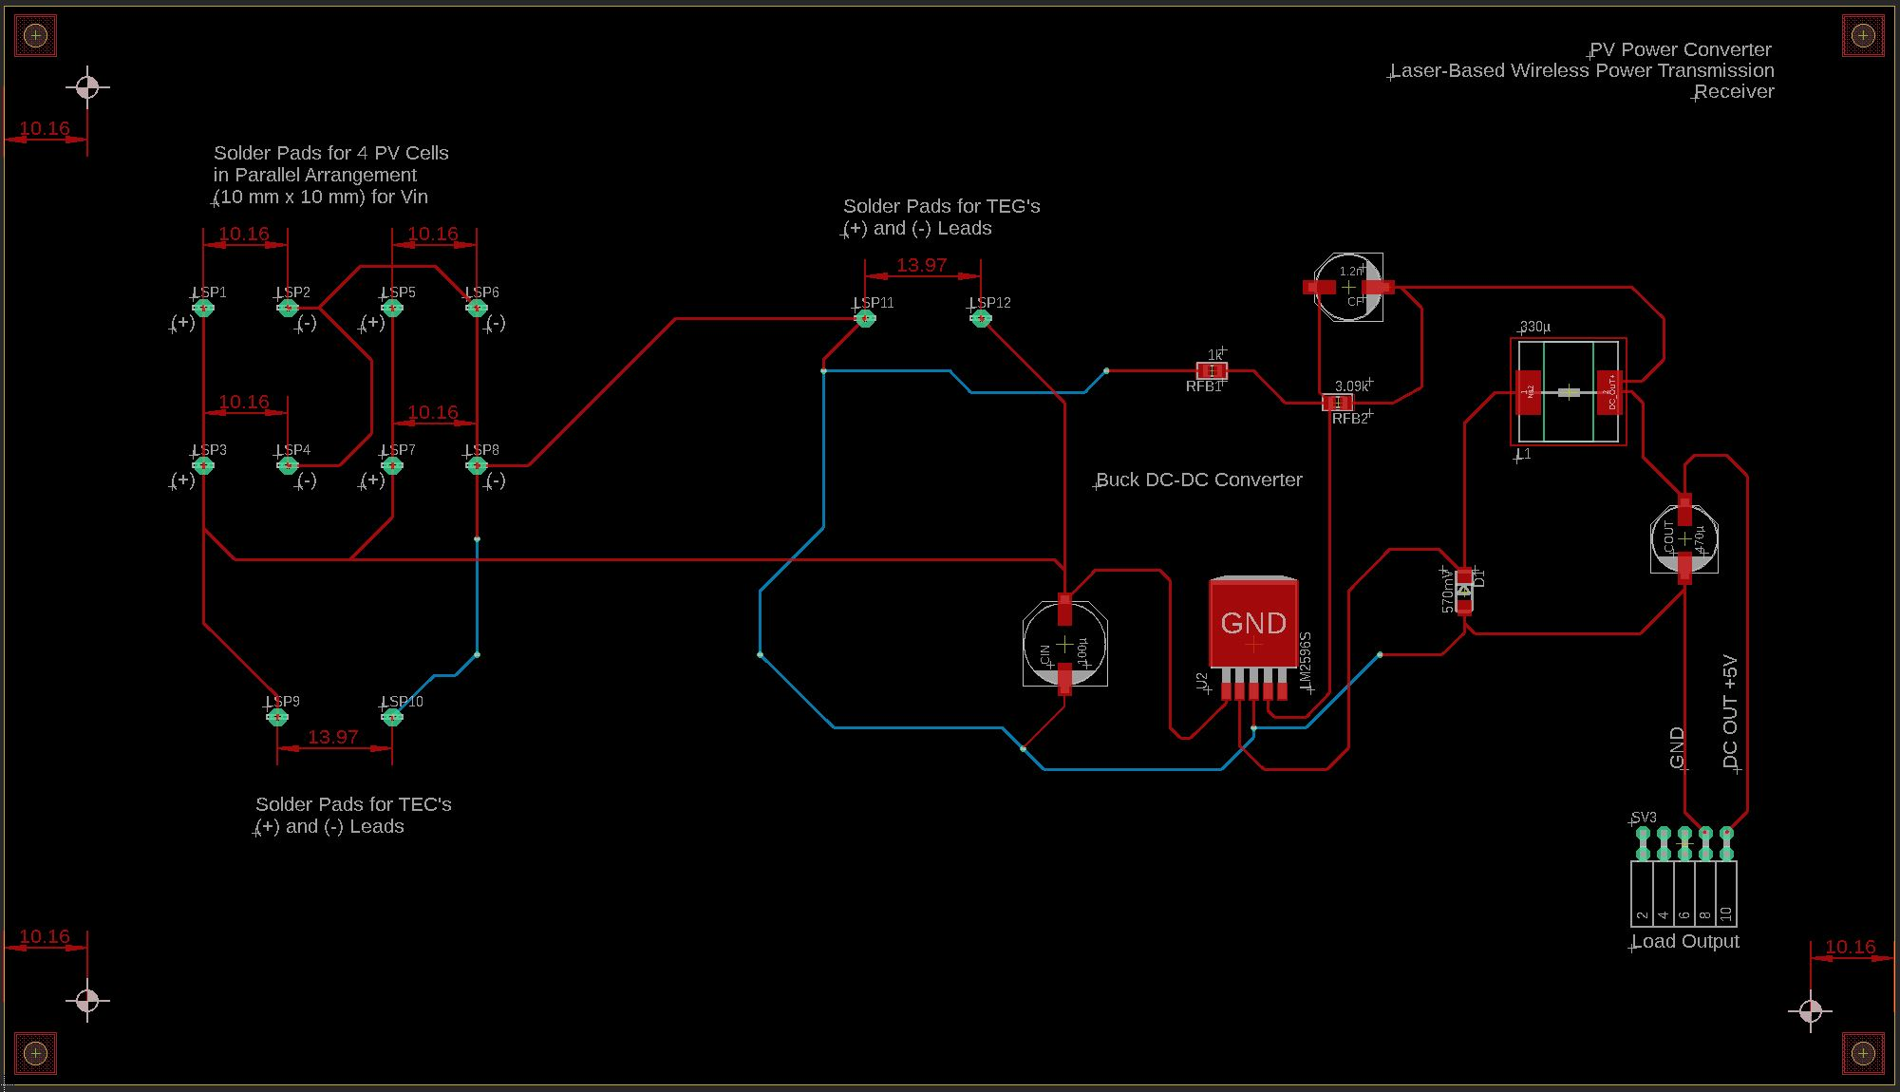
3.

Slide 19
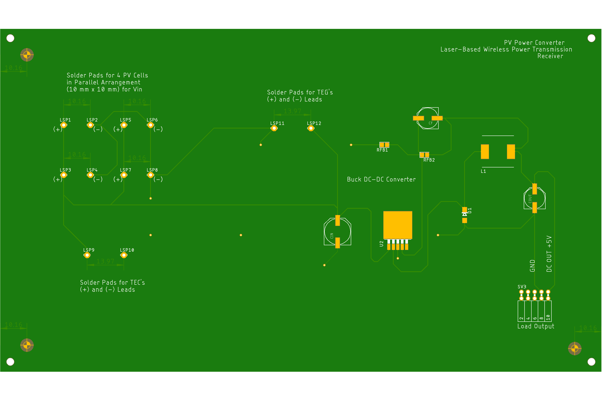
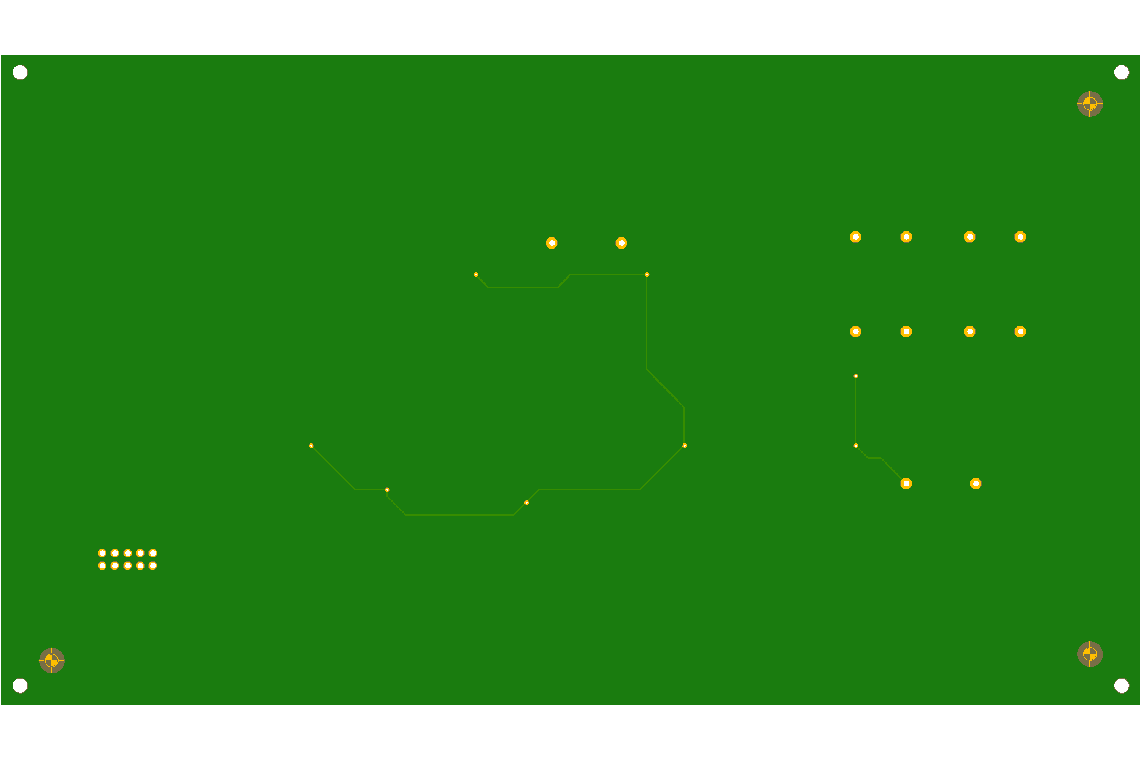
3.
Top
Bottom

Slide 20
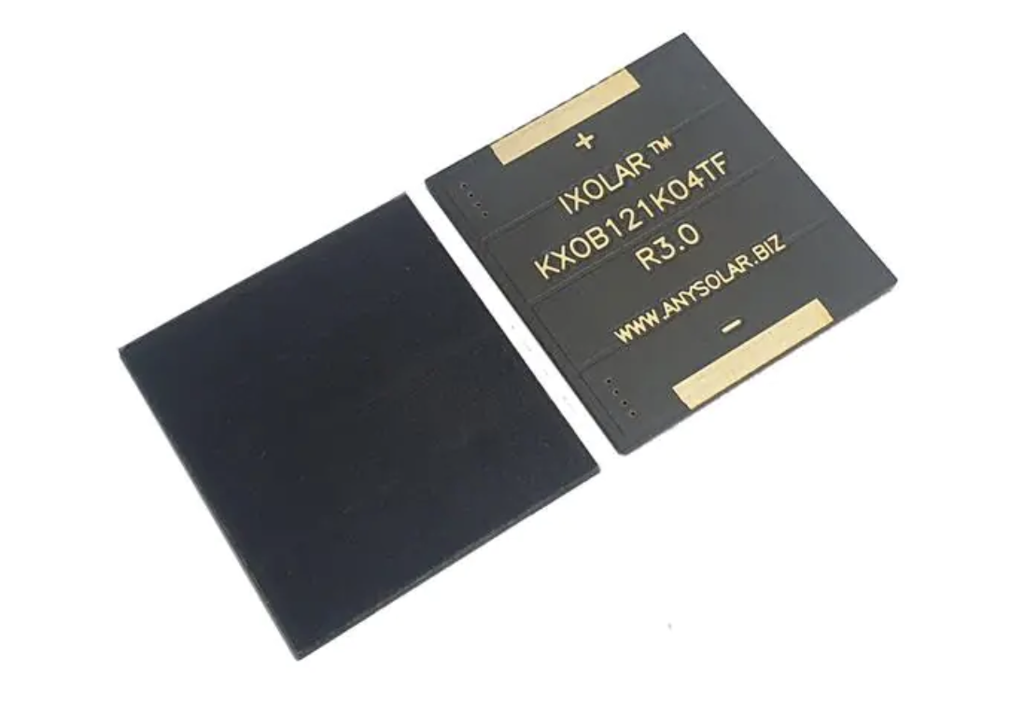
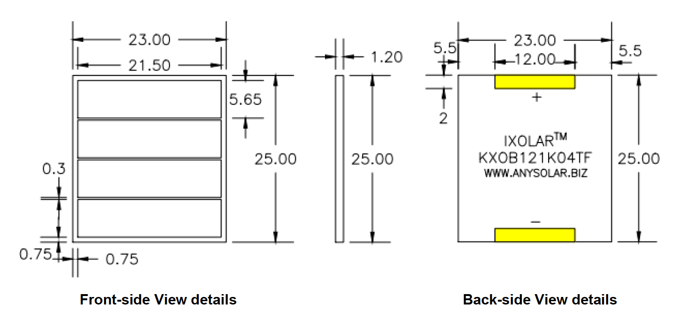
4. Design Specifications, 2.5 cm x 2.5 cm PV Cell Form Factor, 4-PV, Parallel; Extension Board: Configurable for Externally Adaptive Load Circuitry
Peripherals:
Inputs:
PV Array: 2 leads (+ and -) x 4 PV cells = 8 leads
TEG module’s 2 leads (+ and -)
TEC module’s 2 leads (+ and -)
Outputs:
ESP-32 Wi-Fi camera
Internals:
Pads for soldered PV cells
I/O Ports as Female Connectors
Voltage Requirements:
Input:
Each PV cell has a 0.0472 A current output at P_{mpp}
Each PV cell has a 2.23 V voltage output at P_{mpp}
Each PV cell has a 0.1053 W maximum power output
Output: 5 V at 180 mA or 0.18 A = 0.9 W
Miscellaneous:
Heat Sink
*Required Separately: Boost DC-DC Converter circuit: 2.23 V to 5 V

Slide 21
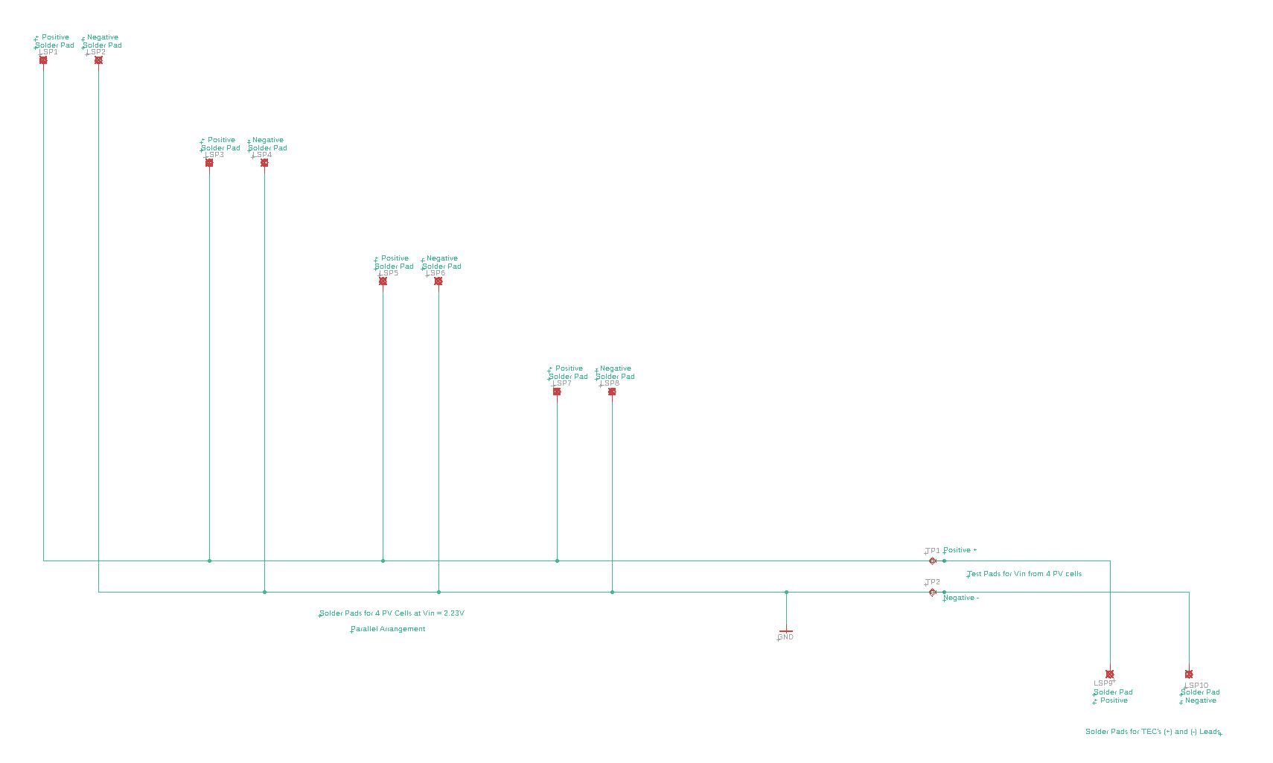
4.

Slide 22
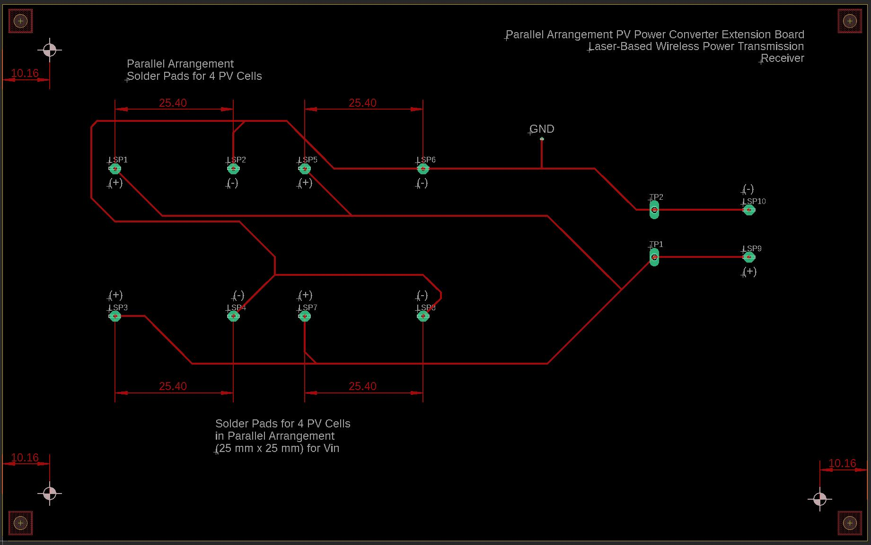
4.

Slide 23
5. Design Specifications, 2.5 cm x 2.5 cm PV Cell Form Factor, 4-PV, Series; Full Backplane Board
Peripherals:
Inputs:
PV Array: 2 leads (+ and -) leads
TEG module’s 2 leads (+ and -)
TEC module’s 2 leads (+ and -)
Outputs:
ESP-32 Wi-Fi camera
Internals:
Pads for soldered PV cells
PWM Control DSP, MCU, or FPGA for Switch Control
Buck DC-DC Converter circuit with Low-Pass Filter: 8.92 V to 5 V
- R, L, C, MOSFET Switch (Voltage-Controlled)
I/O Ports as Female Connectors
Voltage Requirements:
Input: 8 - 30 V:
Each PV cell has a 0.1053 W maximum power output
Each PV cell has a 2.23 V voltage output at Pmpp
Total V_{out} = 2.23 V x 4 PV cells; Voltage output = 8.92 V for a series connection
Total current = 0.0472 A current output at Pmpp for a series connection
Output: 5 V at 180 mA or 0.18 A = 0.9 W
Miscellaneous:
Heat Sink

Slide 24
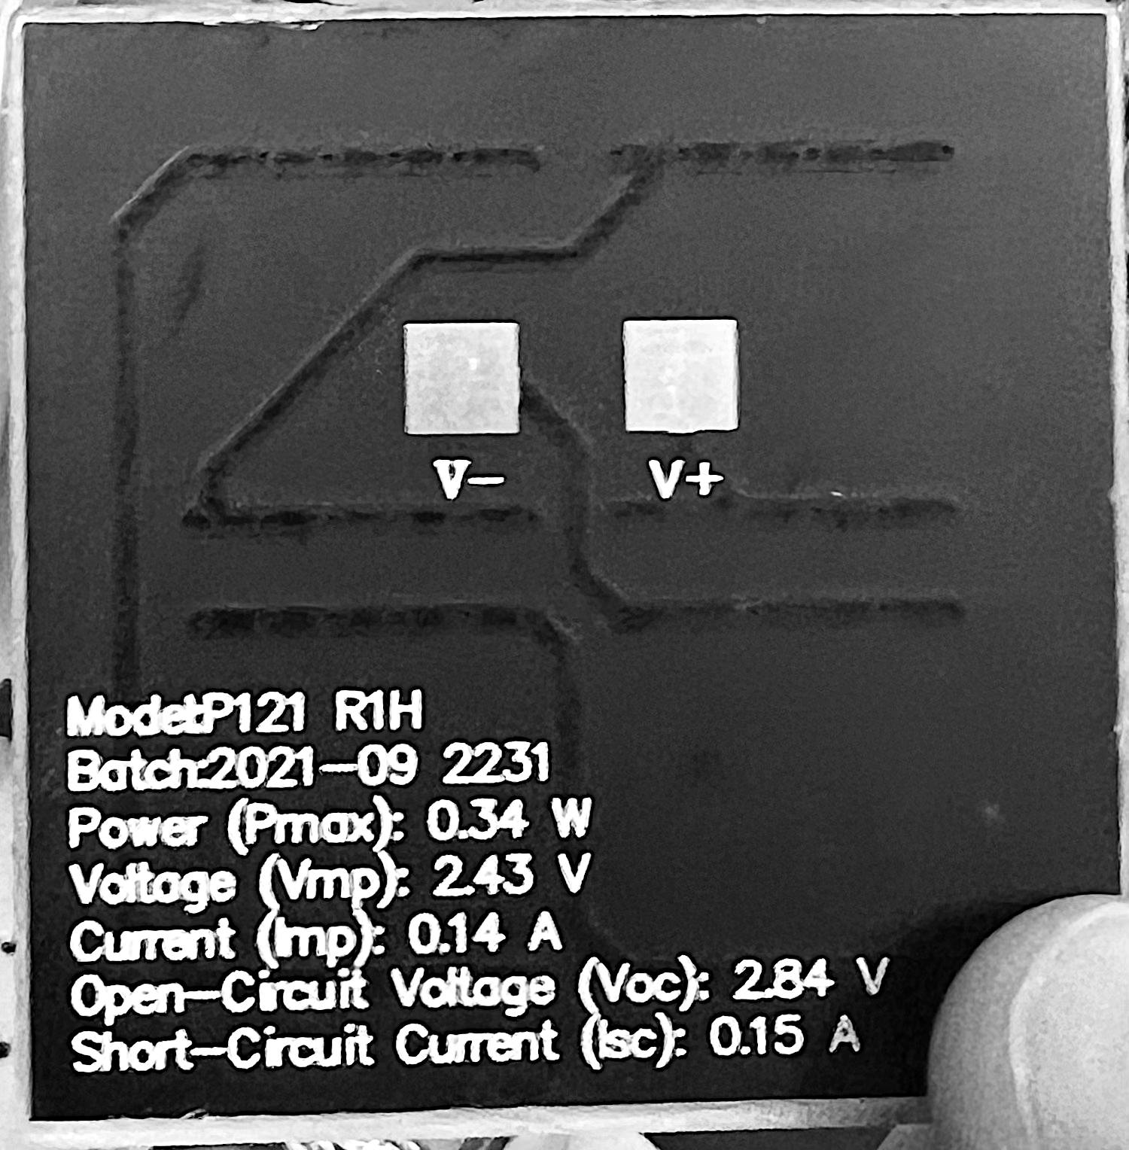
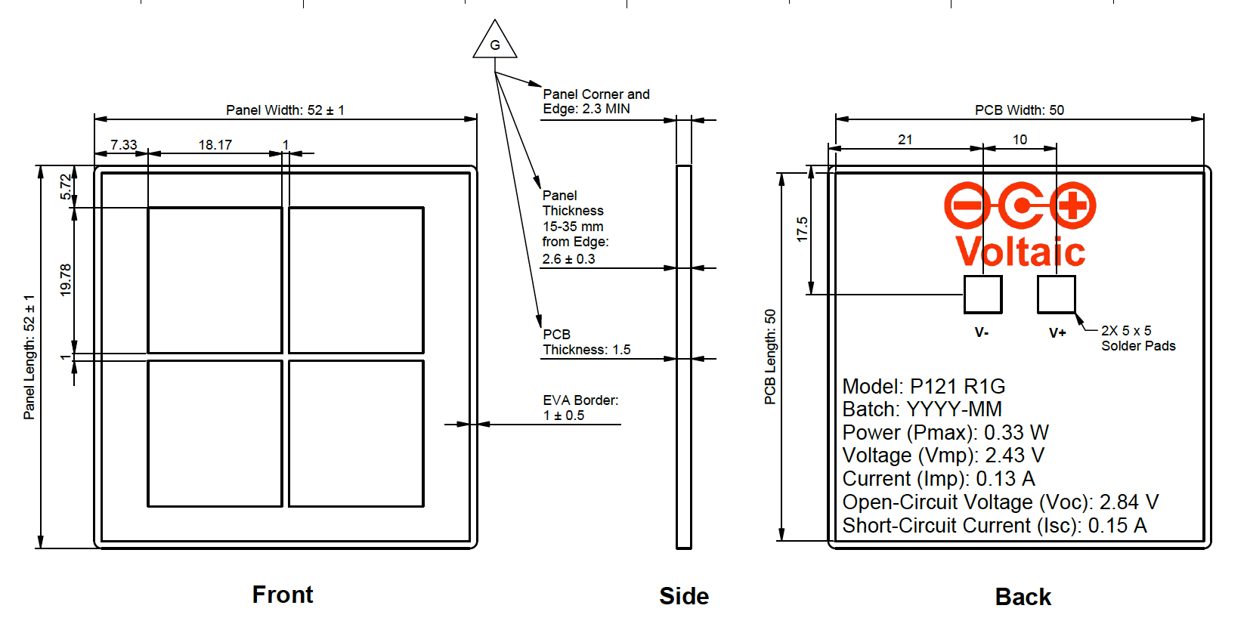
6. Design Specifications, 5 cm x 5 cm PV Cell Form Factor, 4-PV, Series; Full Backplane Board
Peripherals:
Inputs:
PV Array: 2 leads (+ and -) leads
TEG module’s 2 leads (+ and -)
TEC
Outputs:
ESP-32 Wi-Fi camera
Internals:
Pads for soldered PV cells
PWM Control DSP, MCU, or FPGA for Switch Control
Buck DC-DC Converter circuit with Low-Pass Filter: 9.72 V to 5 V
- R, L, C, MOSFET Switch (Voltage-Controlled)
I/O Ports as Female Connectors
Voltage Requirements:
Input: 8 - 30 V:
Each PV cell has a 0.34 W power output
Each PV cell has a 2.43 V voltage output
Total V_{out} = 2.43 V x 4 PV cells; Voltage output = 9.72 V for a series connection
Total current = 0.14 A for a series connection
Output: 5 V at 180 mA or 0.18 A = 0.9 W
Miscellaneous:
Heat Sink

Slide 25
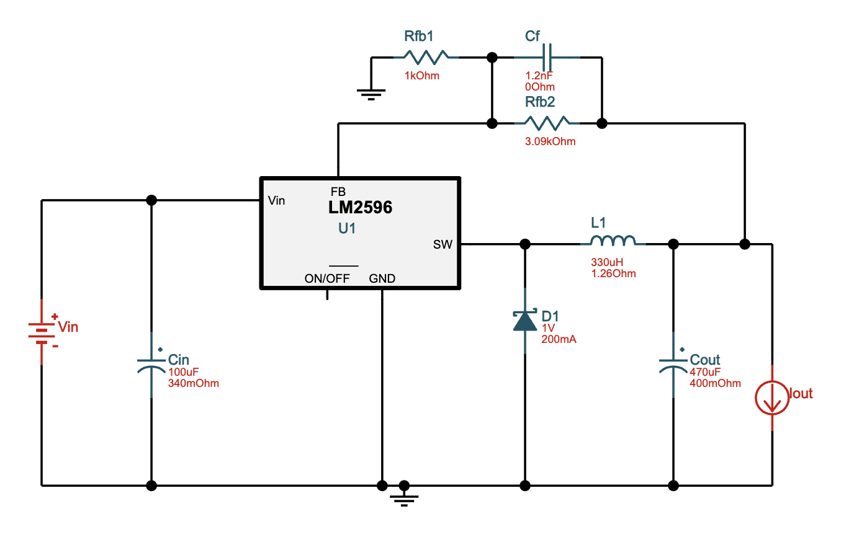
5 & 6. Buck DC-DC Converter
LM2596T-ADJ/NOPB ‑ 8V-30V to 5.00V @ 0.18A. 68.8% Efficiency

Slide 26
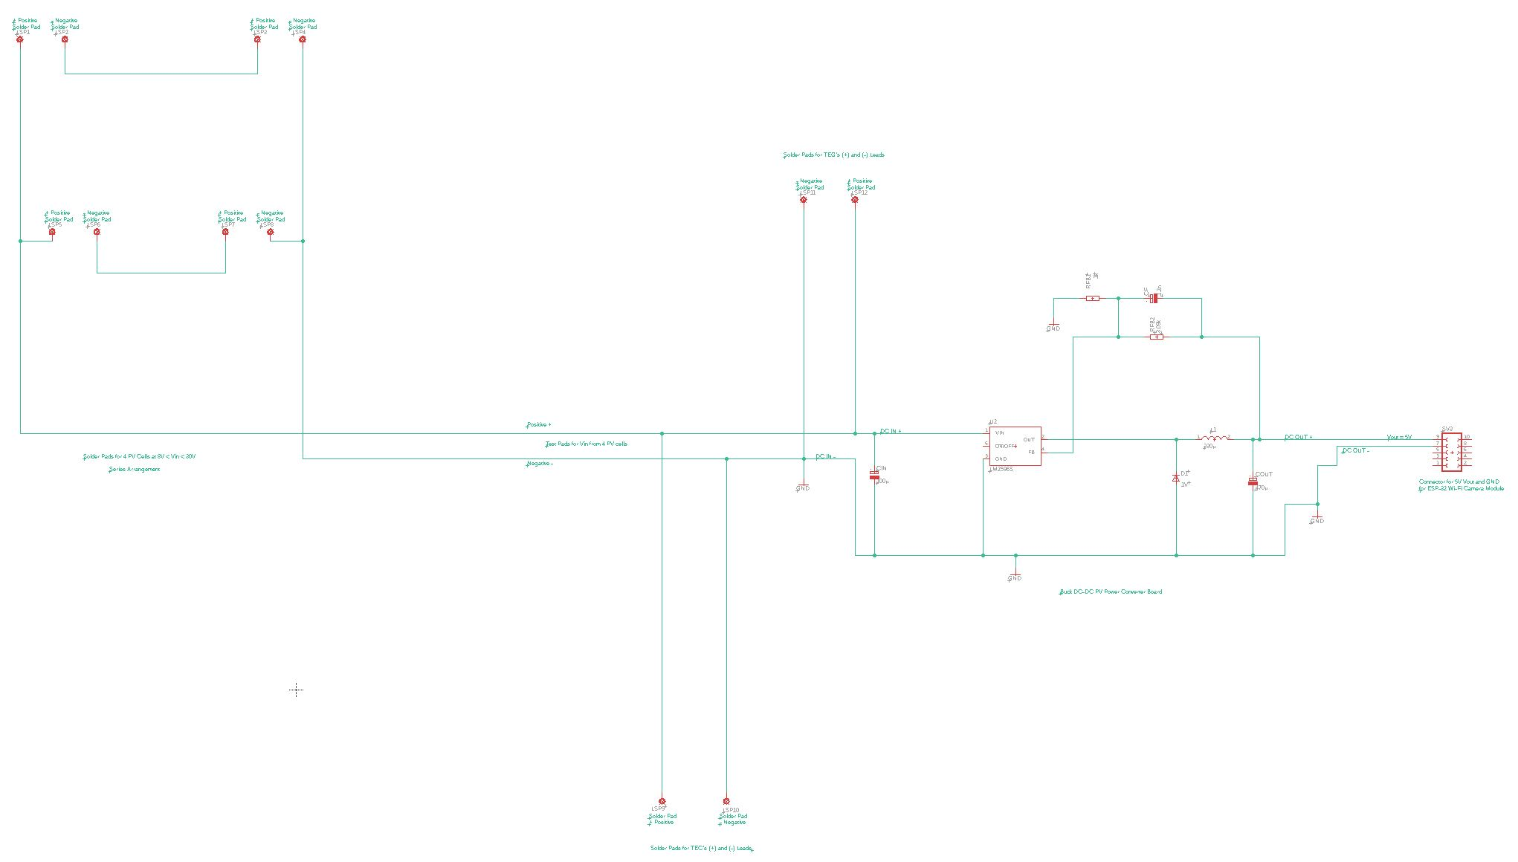
5 & 6.

Slide 27
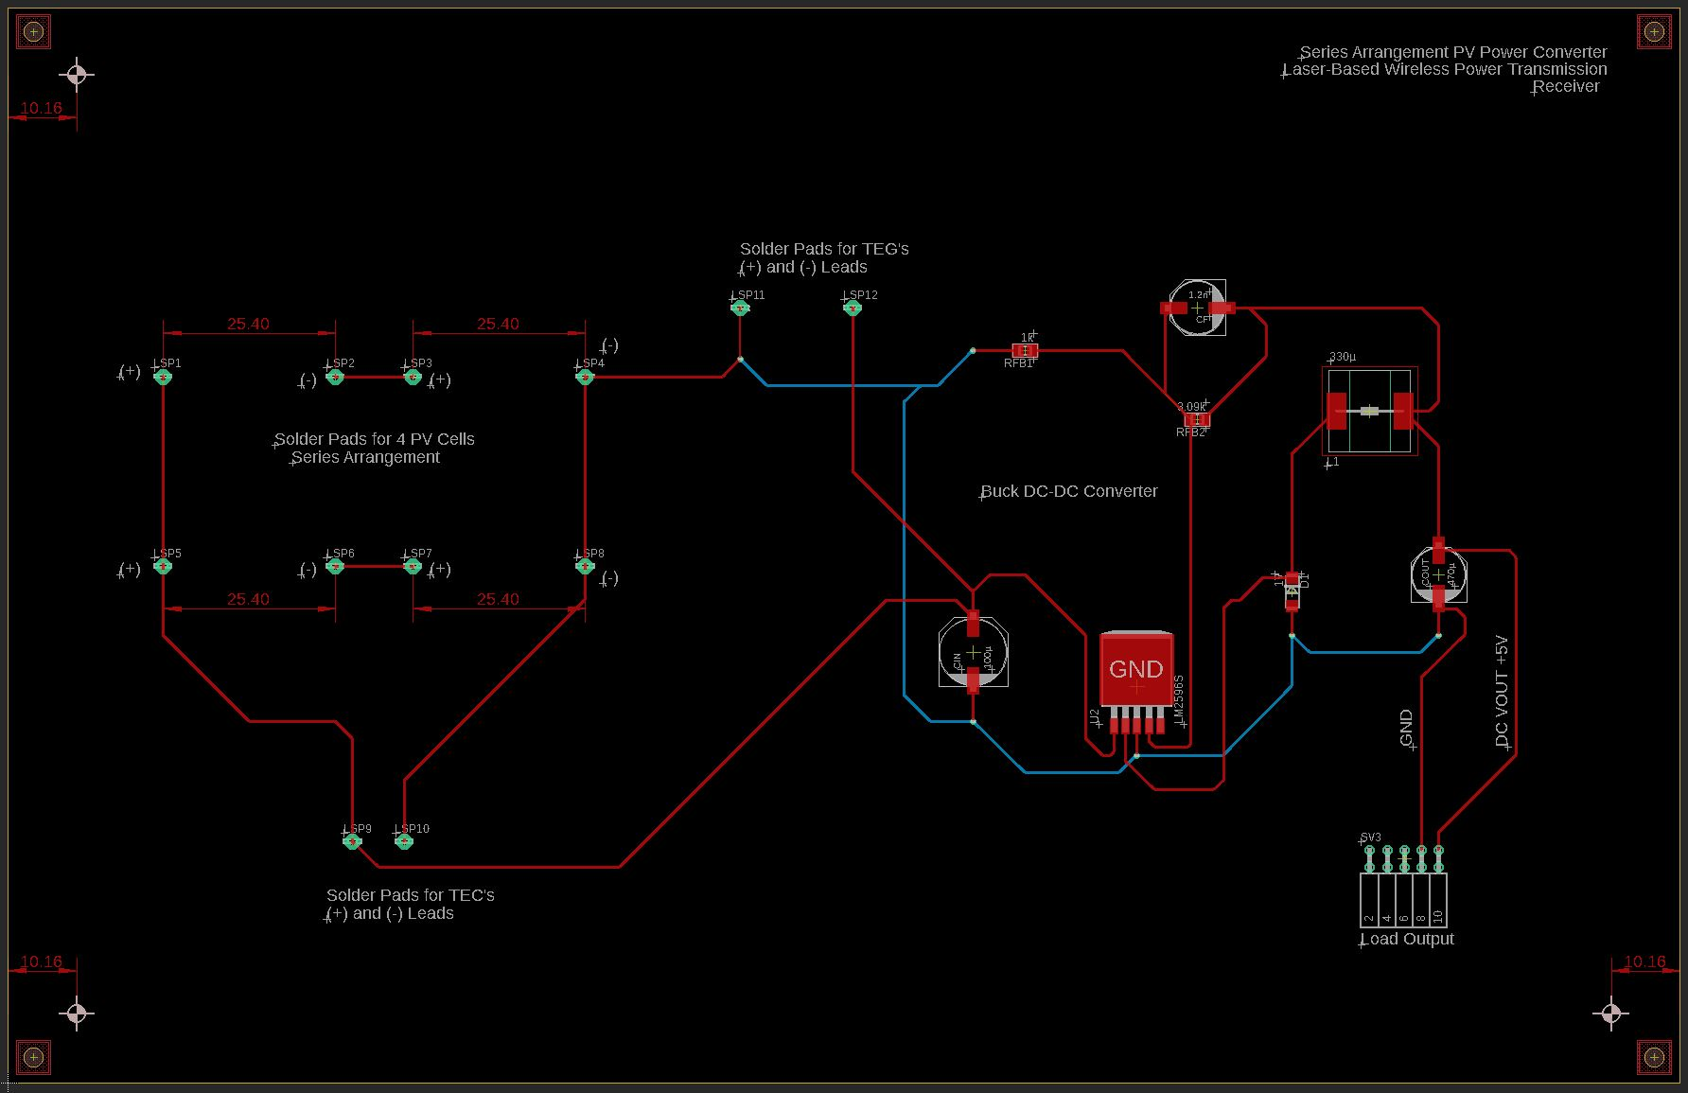
5 & 6.

Slide 28
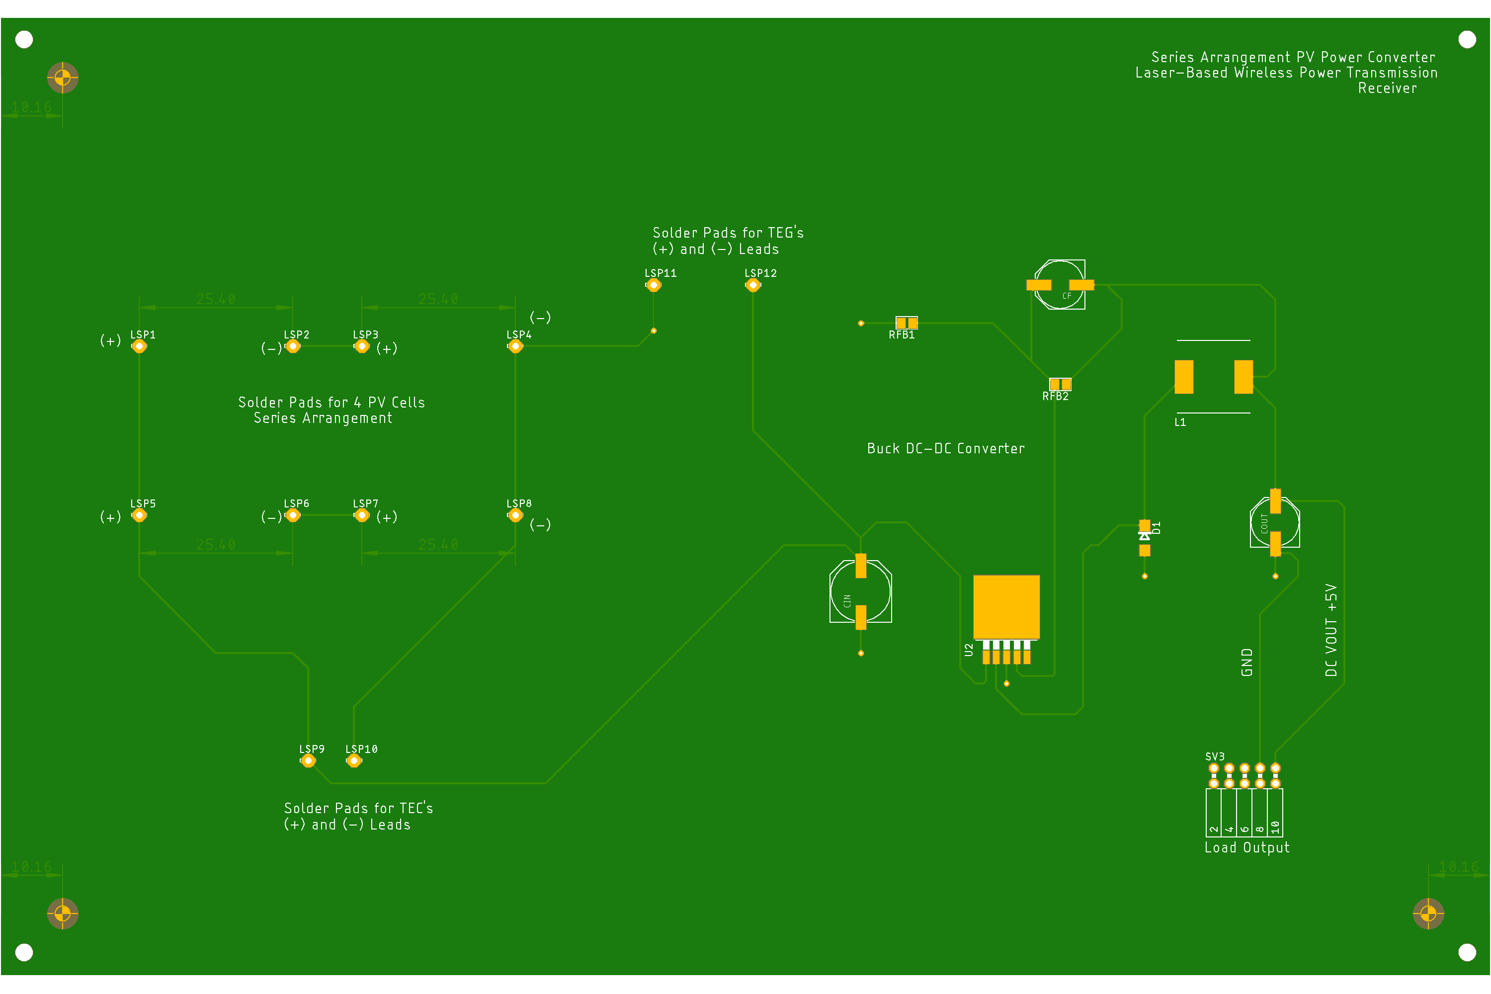
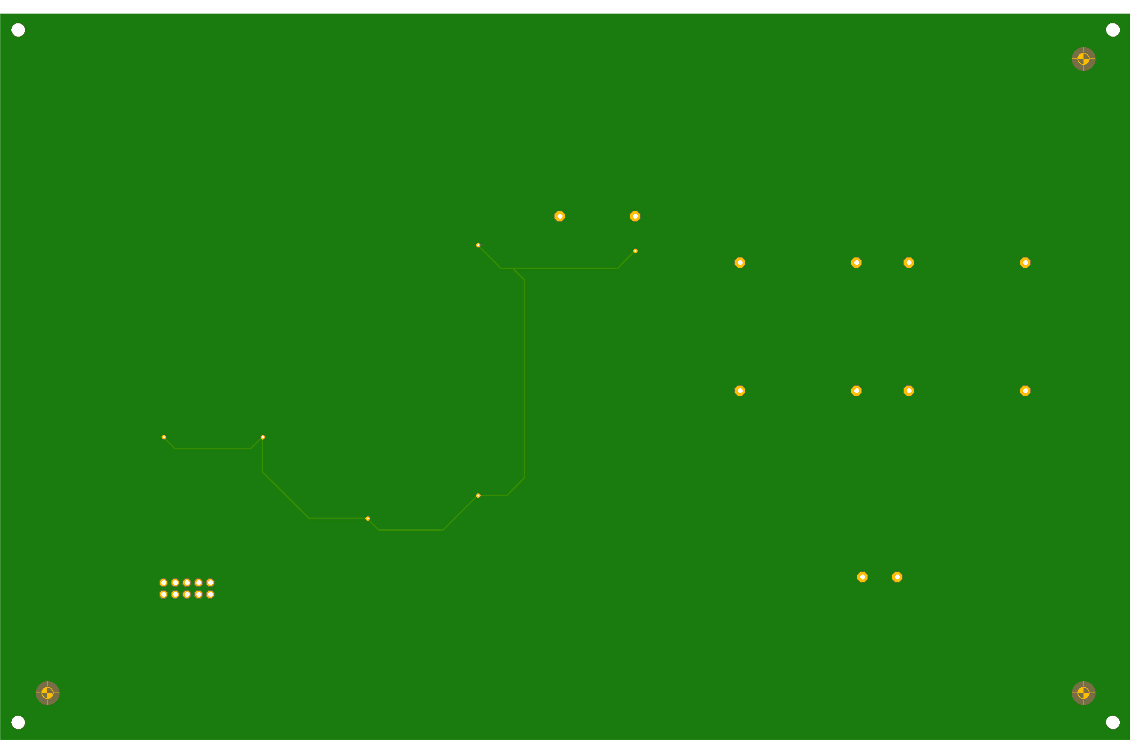
5 & 6.
Top
Bottom

Slide 29
7. Design Specifications, 5 cm x 5 cm PV Cell Form Factor, 4-PV, Series; Backplane Extension Board
Peripherals:
Inputs:
PV Array: 2 leads (+ and -) x 4 PV cells = 8 leads
TEG module’s 2 leads (+ and -)
TEC module’s 2 leads (+ and -)
Outputs:
ESP-32 Wi-Fi camera
Internals:
Pads for soldered PV cells
I/O Ports as Female Connectors
Voltage Requirements:
Input: 8 - 30 V:
Each PV cell has a 0.34 W power output
Each PV cell has a 2.43 V
Total V_{out} = 2.43 V x 4 PV cells; Voltage output = 9.72 V for a series connection
Total current = 0.14 A for a series connection
Output: 5 V at 180 mA or 0.18 A = 0.9 W
Miscellaneous:
Heat Sink
*Required Separately: Buck DC-DC Converter circuit: 9.72 V to 5 V

Slide 30
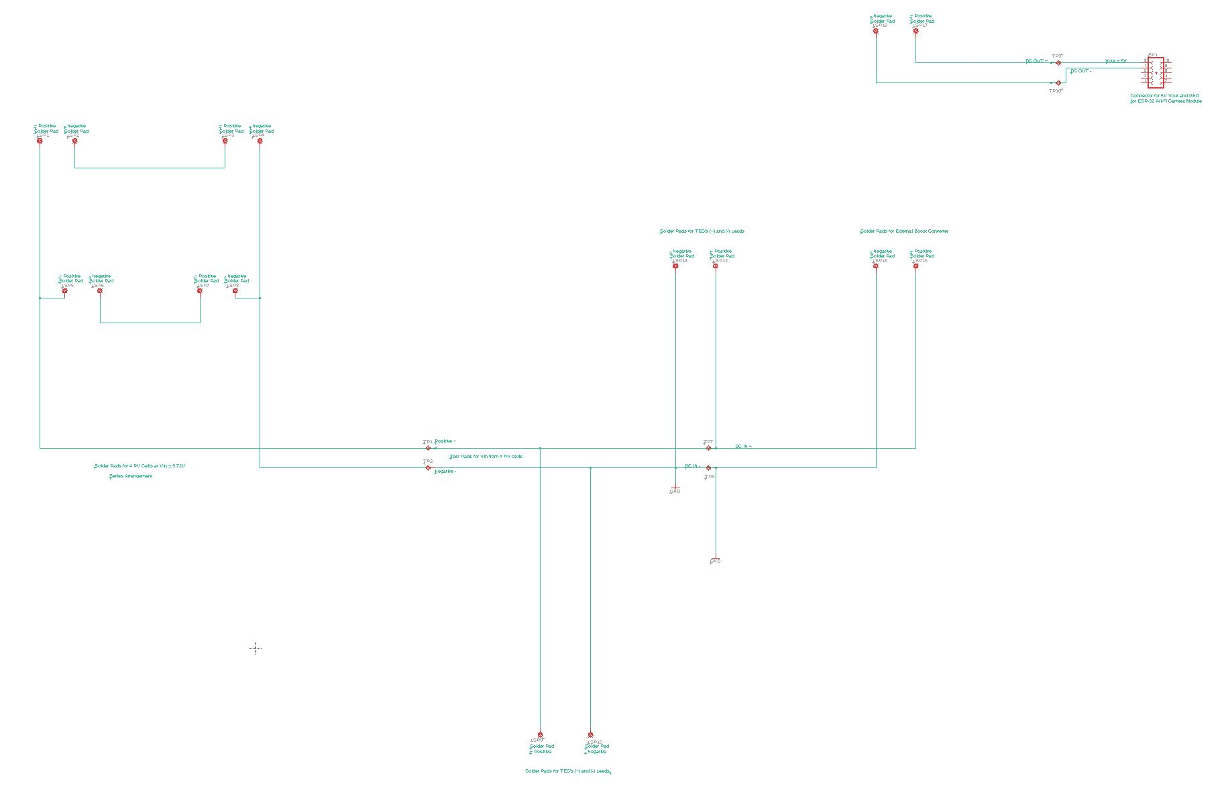
7.

Slide 31
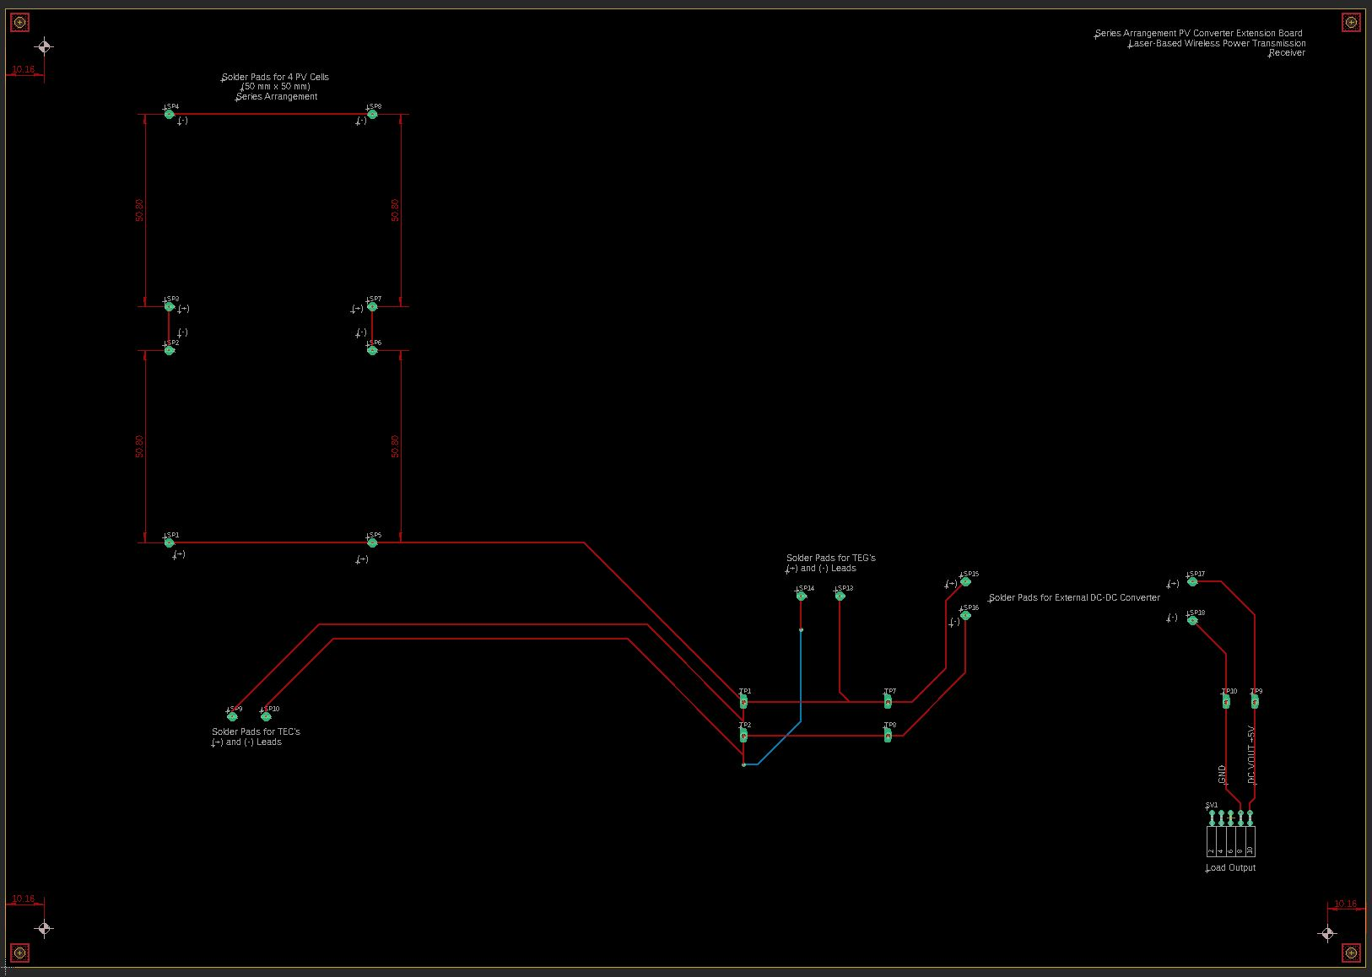
7.

Slide 32
8. Design Specifications, 2.5 cm x 2.5 cm PV Cell Form Factor, 4-PV, Parallel; Backplane Extension Board
Peripherals:
Inputs:
PV Array: 2 leads (+ and -)
TEG module’s 2 leads (+ and -)
TEC module’s 2 leads (+ and -)
Outputs:
ESP-32 Wi-Fi camera
Internals:
Pads for soldered PV cells
I/O Ports as Female Connectors
Voltage Requirements:
Input:
Each PV cell has a 0.1053 W maximum power output
Each PV cell has a 2.23 V voltage output at Pmpp
Total V_{out} = 2.23 V for a parallel connection
Total current = 0.0472 A x 4 PV cells = 0.1888 A for a parallel connection
Total power = 2.23 V x 0.1888 A = 0.421024 W
Output: 5 V at 180 mA or 0.18 A = 0.9 W
Miscellaneous:
Heat Sink
*Required Separately: Boost DC-DC Converter circuit: 2.23 V to 5 V

Slide 33
9. Design Specifications, 5 cm x 5 cm PV Cell Form Factor, 4-PV, Parallel; Backplane Extension Board
Peripherals:
Inputs:
PV Array: 2 leads (+ and -)
TEG module’s 2 leads (+ and -)
TEC
Outputs:
ESP-32 Wi-Fi camera
Internals:
Pads for soldered PV cells
I/O Ports as Female Connectors
Voltage Requirements:
Input:
Each PV cell has a 0.34 W power output
Each PV cell has a 2.43 V voltage output
Total V_{out} = 2.43 V for a parallel connection
Total current = 0.14 A x 4 PV cells = 0.56 A for a parallel connection
Total power = 2.43 V x 0.56 A = 1.3608 W
Output: 5 V at 180 mA or 0.18 A = 0.9 W
Miscellaneous:
Heat Sink
*Required Separately: Boost DC-DC Converter circuit: 2.43 V to 5 V

Slide 34
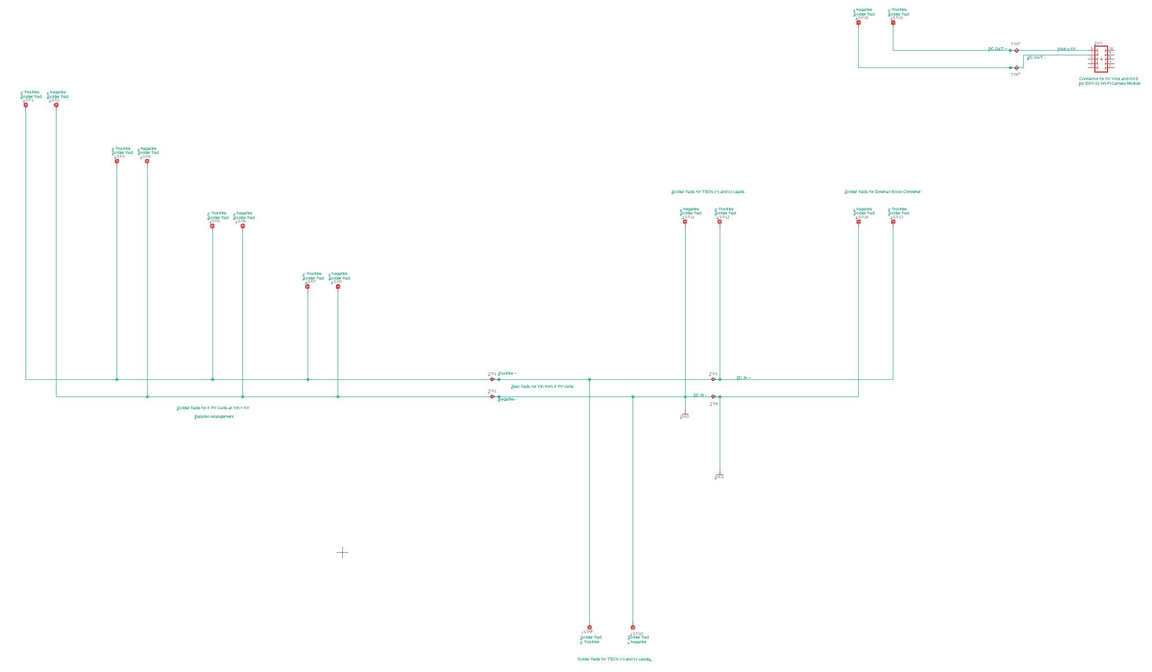
8 & 9.

Slide 35
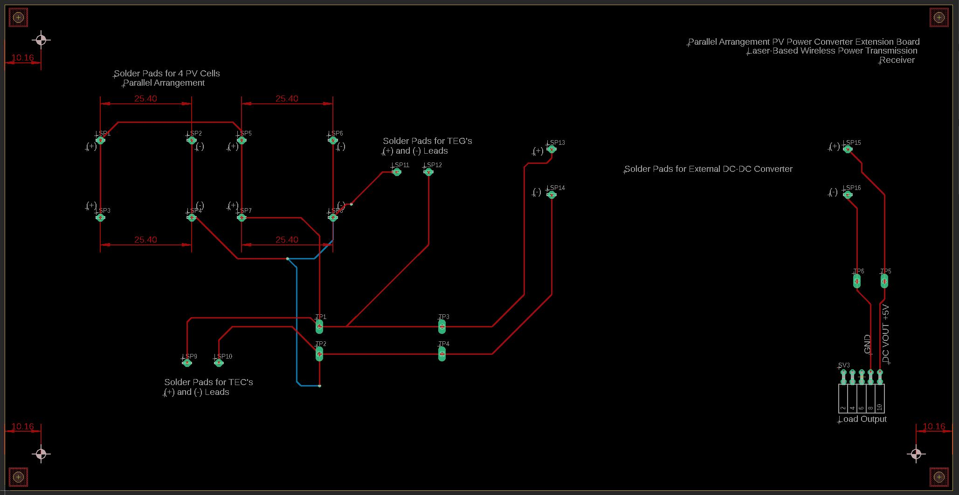
8 & 9.

Slide 36
Printed Circuit Board Design Standard Performance Considerations (IPC-2221A)
From IPC-2221A Specifications (May 2003):
General Requirements on Trace Thicknesses and Tolerances (pg. 4)
Local and Global Fiducials Clearance and Placement (pg. 34-36)
Mechanical Mounting Hole Placement and Dimensions (pg. 33)
Power distribution considerations (pg. 37)
Method of heatsink mounting (e.g., adhesive bond, rivet, screw, etc.) to printed board (pg. 50-52)
Fabrication: 8 Board Panelization (pg. 36)
(Source: http://www-eng.lbl.gov/~shuman/NEXT/CURRENT_DESIGN/TP/MATERIALS/IPC-2221A(L).pdf)

Slide 37
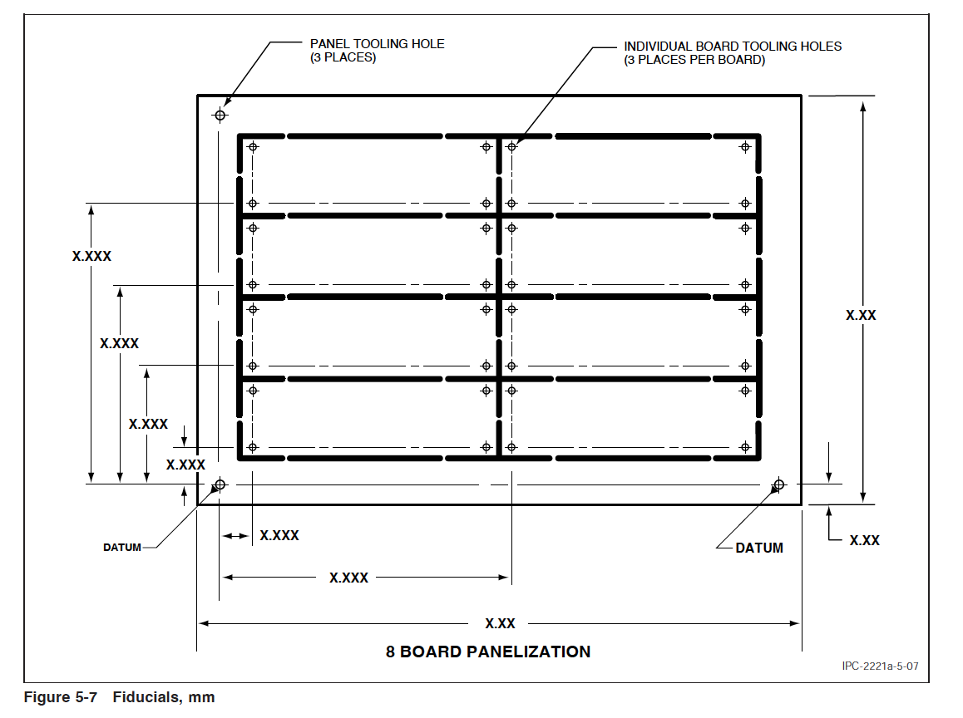
PCB Fabrication: Panelization and Files Generation
Files Generation Requirements from EAGLE:
Download and store predefined CAM files (EAGLE Versions provided by JLCPCB)
2. Generate files for PCB fabrication:
2a. Use CAM Processor in EAGLE
2b. Load CAM Job File and Process Job
2c. Locate ZIP File with Gerber and Drill Files with JLCPCB Naming Conventions
-Delete unnecessary .gpi and .dri files
3. Download a 3rd-party Gerber Viewer Application for final inspection:
3a. Export Gerber/Drill Files into a Gerber Viewer
4. Generate BOM and Centroid Files for SMT for Surface Mount PCB Assembly Service
(Source: https://support.jlcpcb.com/article/137-how-to-generate-gerber-and-drill-files-in-autodesk-eagle)

